Slide 1
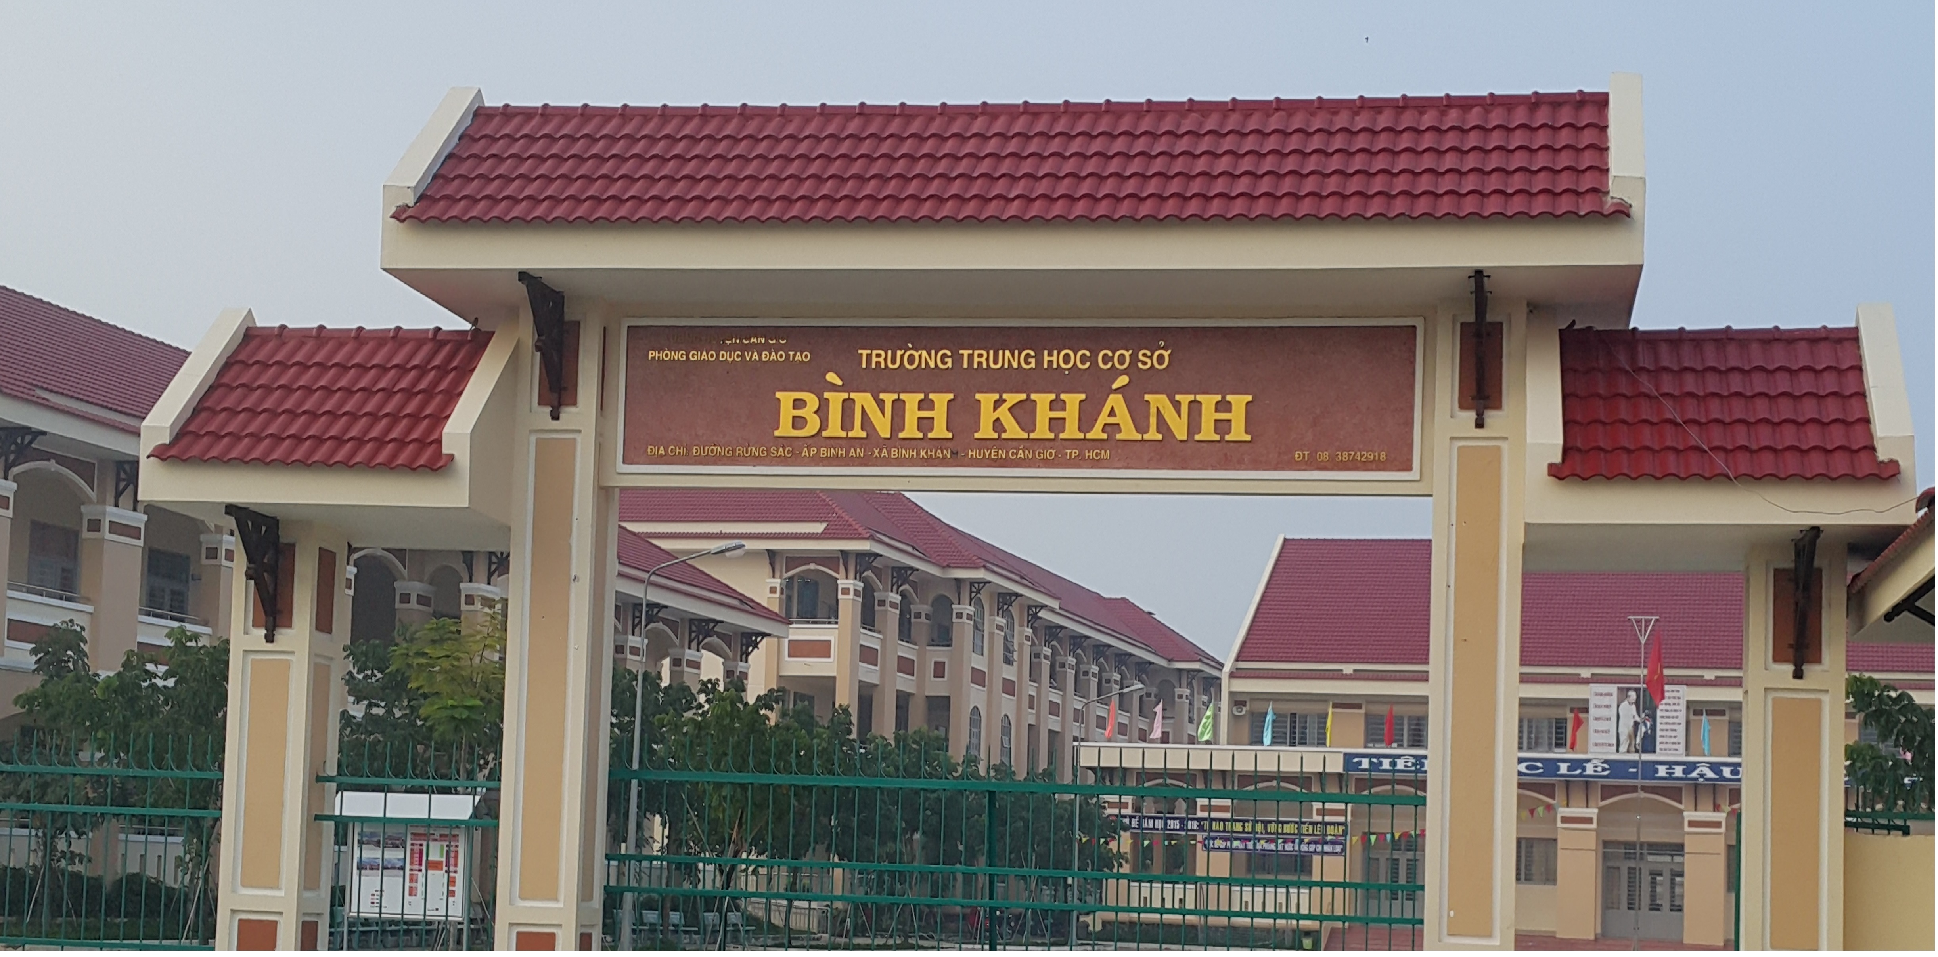
ENGLISH 9
BINH KHANH SECONDARY SCHOOL

Slide 2
Welcome to our class today !
Unit 7: Saving energy

Slide 3
Look at these pictures !
What should we do?

Slide 4
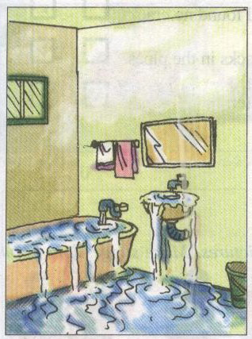
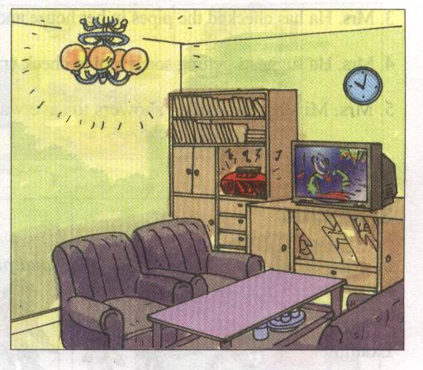
Unit 7: SAVING ENERGY
Lesson 1. Listen and Read
I-Getting started
Look at the pictures. What should the family do to save energy?
- Saving the water
-Turning the lights off
-Turning the radio off
-Save the water
1
-Turning the TV off
-turn the lights off
2
-turn the TV off
4
-turn the radio off
3

Slide 5
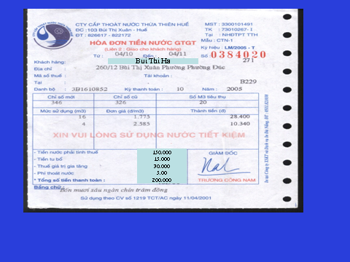
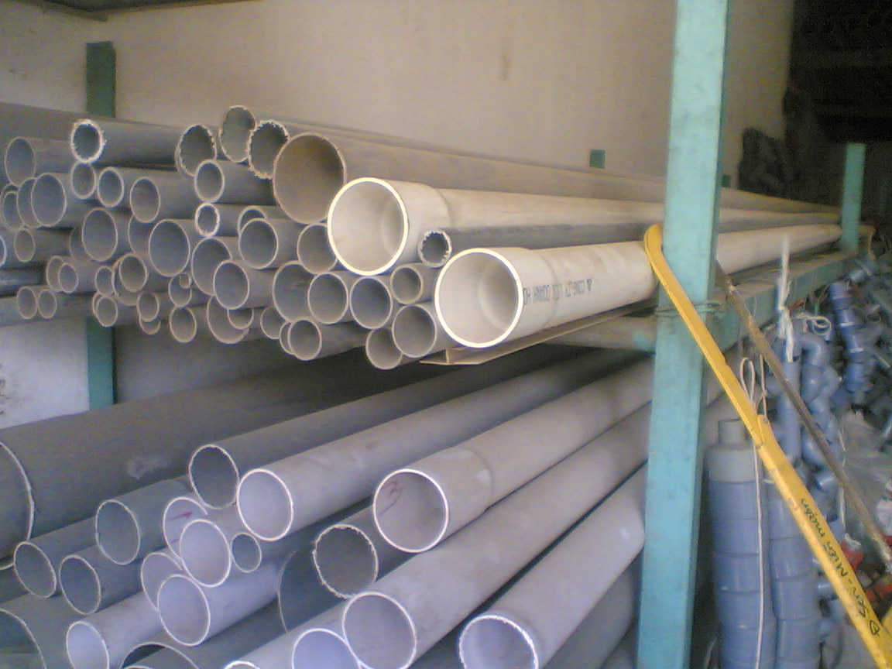
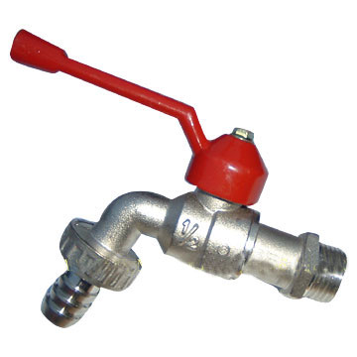
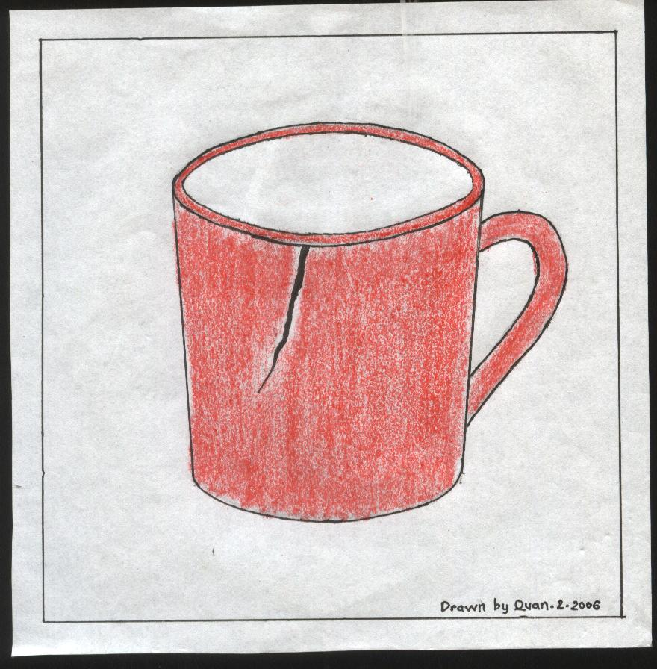
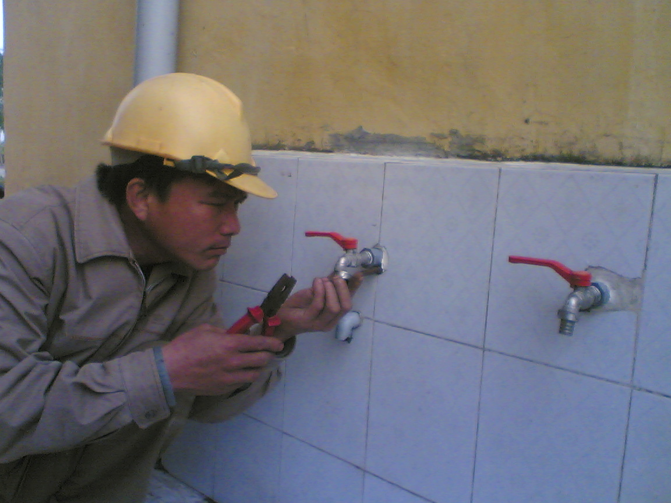
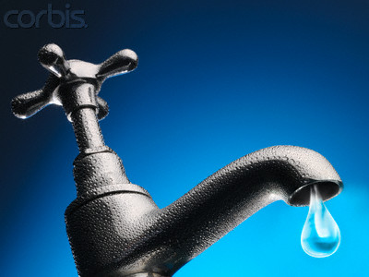
Unit 7: SAVING ENERGY
Lesson 1. Listen and Read
I-Getting started
Look at the pictures. Work with a partner to make a list of things the family could do to save energy.
-Saving the water
-Turning the TV off
-Turning the radio off
-Turning the lights off
II-Listen and read
1-New words
- water bill (n)
- enormous (a)
- a plumber (n)
- crack (n)
- pipe (n)
- faucet (n)
- a dripping faucet (n)
= very big

Slide 6
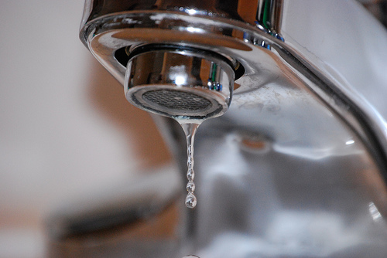
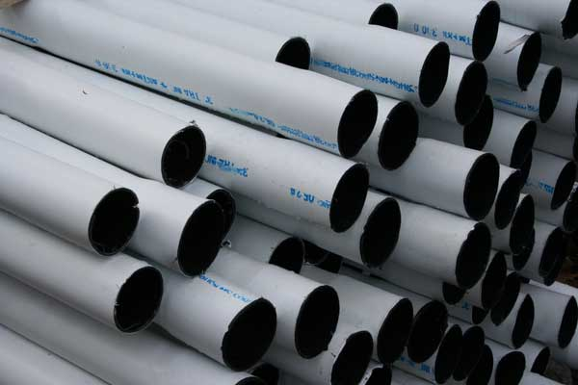
Unit 7: SAVING ENERGY
Lesson 1. Listen and Read
I-Getting started
Look at the pictures. Work with a partner to make a
list of things the family could do to save energy.
-Saving the water
-Turning the TV off
-Turning the radio off
-Turning the lights off
II-Listen and read
1-New words
- water bill
- enormous
- a plumber
- crack
- pipe
- faucet
- a dripping faucet
Exercise one : Complete the sentences by matching the word with the picture.
1-Mr Ba is.............................
2-My ................................this month is low.
3-I’d like to buy a...................................
4-Can you help me with my ................................?
5-Let me check if there is a......................on the cup
6-These .........................are long enough to use.
7-I think my water bill is too............................. this
month.
a plumber
water bill
water bill
enormous
a plumber
faucet
crack
pipes
faucet
dripping faucet
dripping faucet
crack
pipes
high / big
enormous

Slide 7
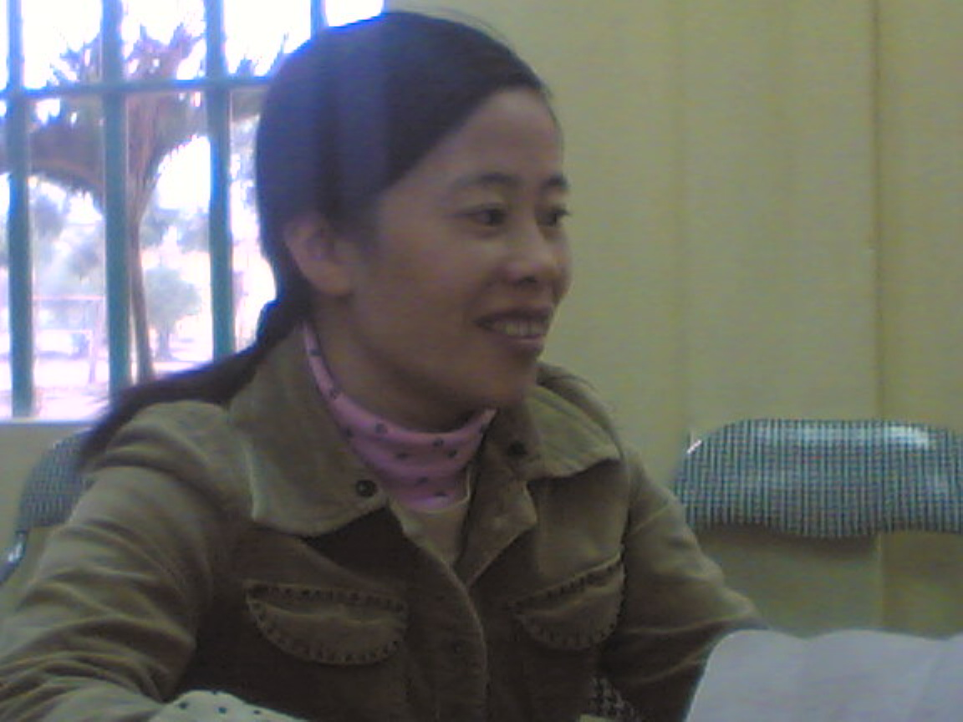
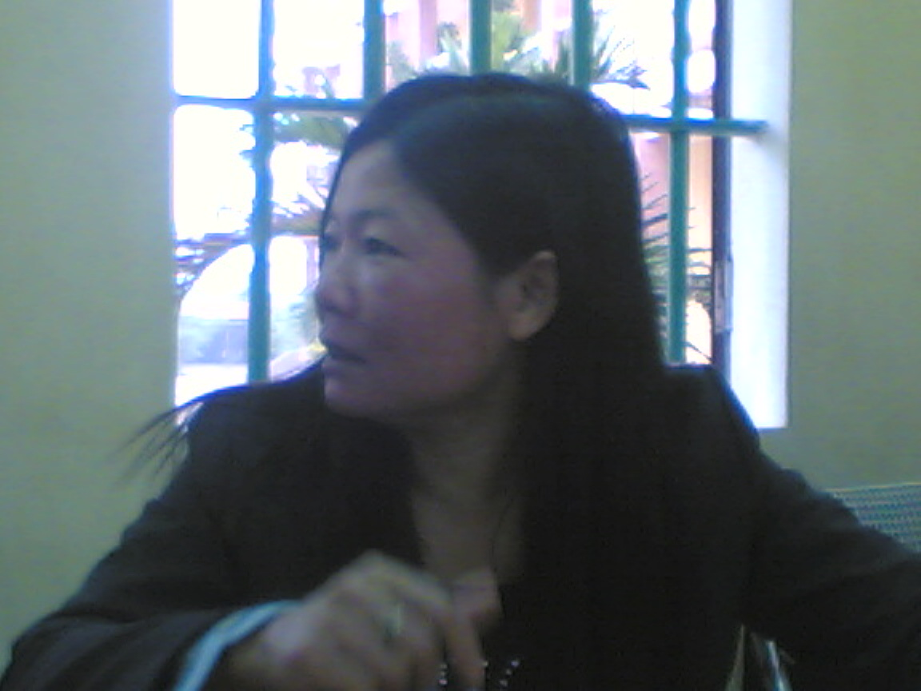
Unit 7: SAVING ENERGY
Lesson 1. Listen and Read
I-Getting started
Look at the pictures. Work with a partner to make a list of things the family could do to save energy.
-Saving the water
-Turning the TV off
-Turning the radio off
-Turning the lights off
II-Listen and read
Mrs. Mi:
What’s the matter, Mrs. Ha?
Mrs. Ha:
I’m worried about my most recent water bill. It’s enormous.
Mrs. Ha:
Mrs. Mi:
Mrs. Mi:
Let me see. 200,000 dong! You should reduce the amount of water your family uses.
1-New words
- water bill (n)
- Enormous (a)
- a plumber
- Crack (n)
- Pipe (n)
- Faucet (n)
- a dripping faucet
Mrs. Ha:
How do I do that?
Mrs. Mi:
First of all, get a plumber to make sure there are no cracks in the pipes.
Mrs. Ha:
I’ll do that.
Baths use twice as much water as showers, so I suggest taking showers. And remember to turn off the faucets. A dripping faucet can waste 500 liters of water a month
Mrs. Mi:
Mrs. Ha:
I see. Thank you.

Slide 8
Unit 7: SAVING ENERGY
Lesson 1. Listen and Read
I-Getting started
Look at the pictures. Work with a partner to make a list of things the family could do to save energy.
-Saving the water
-Turning the TV off
-Turning the radio off
-Turning the lights off
II-Listen and read
Mrs. Mi:
Mrs. Mi:
What’s the matter, Mrs. Ha?
What’s the matter, Mrs. Ha?
I’m worried about my most recent water bill. It’s enormous.
Mrs. Ha:
I’m worried about my most recent water bill. It’s enormous.
Mrs. Ha:
Let me see. 200,000 dong! You should reduce the amount of water your family uses.
Mrs. Mi:
Let me see. 200,000 dong! You should reduce the amount of water your family uses.
Mrs. Mi:
Mrs. Ha:
Mrs. Ha:
How do I do that?
How do I do that?
First of all, get a plumber to make sure there are no cracks in the pipes.
Mrs. Mi:
First of all, get a plumber to make sure there are no cracks in the pipes.
Mrs. Mi:
I’ll do that.
Mrs. Ha:
I’ll do that.
Mrs. Ha:
Baths use twice as much water as showers, so I suggest taking showers. And remember to turn off the faucets. A dripping faucet can waste 500 liters of water a month.
Baths use twice as much water as showers, so I suggest taking showers. And remember to turn off the faucets. A dripping faucet can waste 500 liters of water a month
Mrs. Mi:
Mrs. Mi:
I see. Thank you.
Mrs. Ha:
I see. Thank you.
Mrs. Ha:

Slide 9
Unit 7: SAVING ENERGY
Lesson 1. Listen and Read
I-Getting started
Look at the pictures. Work with a partner to make a
list of things the family could do to save energy.
-Saving the water
-Turning the TV off
-Turning the radio off
-Turning the lights off
II-Listen and read
1-New words
- water bill
- enormous
- a plumber
- crack
- pipe
- faucet
- a dripping faucet
2-Practice the dialogue with your partner
Mrs. Mi:
What’s the matter, Mrs. Ha?
Mrs. Ha:
I’m worried about my most recent water bill. It’s enormous.
Mrs. Mi:
Let me see. 200,000 dong! You should reduce the amount of water your family uses.
Mrs. Ha:
How do I do that?
Mrs. Mi:
First of all, get a plumber to make sure there are no cracks in the pipes.
Mrs. Ha:
I’ll do that.
Work in pairs, please!
Baths use twice as much water as showers, so I suggest taking showers. And remember to turn off the faucets. A dripping faucet can waste 500 liters of water a month
Mrs. Mi:
Mrs. Ha:
I see. Thank you.

Slide 10
Unit 7: SAVING ENERGY
Lesson 1. Listen and Read
I-Getting started
Look at the pictures. Work with a partner to make
a list of things the family could do to save energy.
-Saving the water
-Turning the TV off
-Turning the radio off
-Turning the lights off
II-Listen and read
1-New words
- water bill
- enormous
- a plumber
- crack
- pipe
- faucet
- a dripping faucet
2-Practice the dialogue with your partner
Exercise: True False statement prediction.
True False statement prediction.
1- Mrs. Ha is worried about her water bill.
2- Mrs. Mi gives Mrs. Ha advice on how to save water.
3- Mrs. Ha has checked the pipes in her house and found no cracks.
4-Mrs. Ha suggests getting some tool to check cracks in the pipes.
5- Mrs. Mi suggests taking showers to save water.
T
F
Let’s check!

Slide 11
Unit 7: SAVING ENERGY
Lesson 1. Listen and Read
Mrs. Mi: What’s the matter, Mrs. Ha?
Mrs. Ha: I’m worried about my most recent water bill. It’s enormous.
Mrs. Mi: Let me see. 200,000 dong! You should reduce the amount of water your family uses.
Mrs. Ha: How do I do that?
Mrs. Mi: First of all, get a plumber to make sure there are no cracks in the pipes.
Mrs. Ha: I’ll do that.
Mrs. Mi: Baths use twice as much water as showers, so I suggest taking showers. And remember to turn off the faucets. A dripping faucet can waste 500 liters of water a month
Mrs.Ha: I see. Thank you.
True or False. Correct the False statements.
1- Mrs. Ha is worried about her water bill.
2- Mrs. Mi gives Mrs. Ha advice on how to save water.
3- Mrs. Ha has checked the pipes in her house and found no cracks.
4-Mrs. Ha suggests getting some tool to check cracks in the pipes.
5- Mrs. Mi suggests taking showers to save water.
T
F
T
First of all, get a plumber to make sure there are no cracks in the pipes.
T
F
⇨ Mrs. Ha will get a plumber to check the pipes in her house.
F
⇨ Mrs. Mi suggests getting a plumber to check the pipes in Mrs. Ha’s house.
T

Slide 12
Unit 7: SAVING ENERGY
Lesson 1. Listen and Read
I-Getting started
Look at the pictures. Work with a partner to make a list of things the family could do to save energy.
-Saving the water
-Turning the TV off
-Turning the radio off
-Turning the lights off
II-Listen and read
1-New words
- water bill
- enormous
- a plumber
- crack
- pipe
- faucet
- a dripping faucet
2-Practice the dialogue with your partner
Exercise: True or False. Correct the False statements.
1- T
2- T
3- F ⇨ Mrs. Ha will get a plumber to check the pipes in her house
4- F ⇨ Mrs. Mi suggests getting a plumber to check the pipes in Mrs. Ha’s house
5- T
True or False. Correct the False statements.
1- Mrs. Ha is worried about her water bill.
2- Mrs. Mi gives Mrs. Ha advice on how to save water.
3- Mrs. Ha has checked the pipes in her house and found no cracks.
4-Mrs. Ha suggests getting some tool to check cracks in the pipes.
5- Mrs. Mi suggests taking showers to save water.
T
F
T
T
F
F
T

Slide 13
Unit 7: SAVING ENERGY
Lesson 1. Listen and Read
I-Getting started
Look at the pictures. Work with a partner to make a list of things the family could do to save energy.
-Saving the water -Turning off the TV
-Turning the radio off -Turning off the lights.
II-Listen and read
1-New words
- water bill - enormous
- a plumber - crack
- pipe - faucet
- a dripping faucet
2-Practice the dialogue with your partner
Exercise: True or False? Correct the False statements.
1- T
2- T
3- F ⇨ Mrs. Ha will get a plumber to check the pipes in her house
4- F ⇨ Mrs. Mi suggests getting a plumber to check the pipes in Mrs. Ha’s house
5- T
Look at the pictures and give some advice!
3. Grammar.
Example: - I suggest taking showers.
or I suggest we should take showers.
Form: S + suggest + V_ing
S1 + suggest (that) + S2 + should + V_infi.
Use: - to give advice.

Slide 14
Unit 7: SAVING ENERGY
Lesson 1. Listen and Read
I-Getting started
Look at the pictures. Work with a partner to make a list of things the family could do to save energy.
-Saving the water -Turning off the TV
-Turning the radio off -Turning off the lights.
II-Listen and read
1-New words
- water bill - enormous
- a plumber - crack
- pipe - faucet
- a dripping faucet
2-Practice the dialogue with your partner
Exercise: True or False? Correct the False statements.
1- T
2- T
3- F ⇨ Mrs. Ha will get a plumber to check the pipes in her house
4- F ⇨ Mrs. Mi suggests getting a plumber to check the pipes in Mrs. Ha’s house
5- T
III-Homework
1-Learn the new words by heart.
2- Make a list of things we should to save energy.
3. Grammar.
Example: - I suggest taking showers.
or I suggest we should take showers.
Form: S + suggest + V_ing
S1 + suggest + S2 + should + V_infi.
Use: - to give advice.

Slide 15
Thank you for attending !
Good bye !
Thanks for attending !
See you !

